Slide 1
Facial Recognition
Team:
Sai Revanth Sivaraju
Vamsi Krishna Satyasi
Rajashekar Vennavelli
COEN 240 Machine Learning

Slide 2
Pipeline Overview
Data Curation
Data Augmentation
Feature Extraction
Model Training
Model Evaluation
We grouped the images based on each person. Images of a particular person is grouped under one folder and the folder name is the student name.
Preprocess: MTCNN
Brightness,
horizontal flip,
rotation,
zoom range
Facenet
ResNet50
KNN
SVM
Bayesian
Decision Tree
Accuracy
Precision
Recall
F1 Score

Slide 3
Data Curation
After using MTCNN for face detection and labeling the images, we are grouping images of particular person under one folder. And the folder name will be the person name.
Multi-Task Cascaded Convolutional Networks (MTCNN) algorithm
Initial Detection Stage: Identifies potential faces within the input images.
Facial Landmark Localization Stage: Determines the precise locations of key facial features within the detected faces.
Bounding Box Refinement Stage: Enhances the accuracy of the face bounding boxes by adjusting their positions and sizes as needed.
Other Algorithms which we experimented with : Haar Cascade, Deepface

Slide 4
Data Augmentation and Label Encoding
Data Augmentation
Flip
Zoom Ratio
Rotation
Brightness
Initial Dataset : 274
Augmented Dataset : 1644
Horizontal Flip

Slide 5
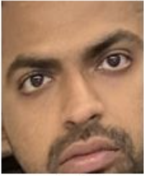
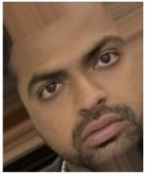
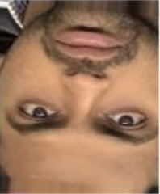
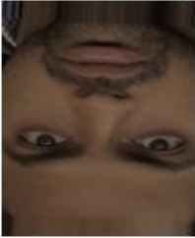
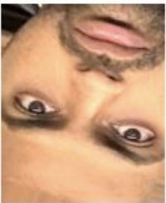
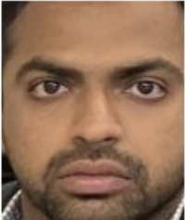

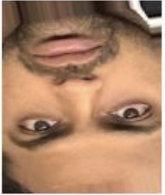
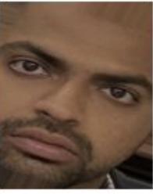
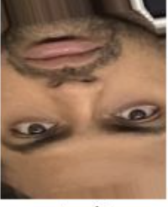
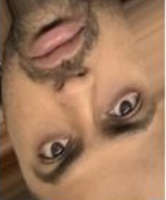
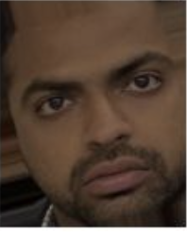
Data Augmentation and Label Encoding

Slide 6
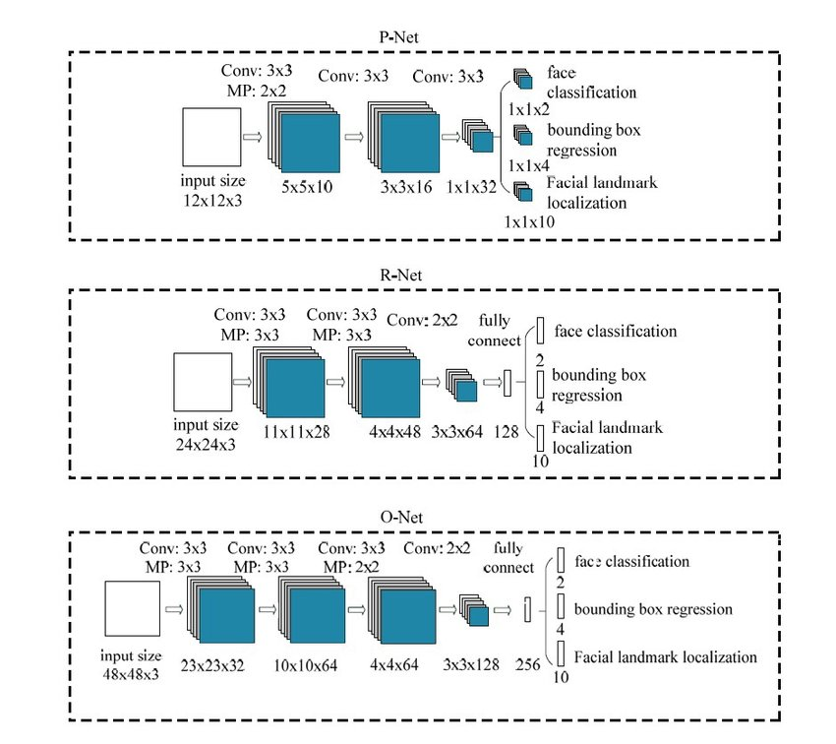
MTCNN: Multi-task Cascaded Convolutional Networks

Slide 7
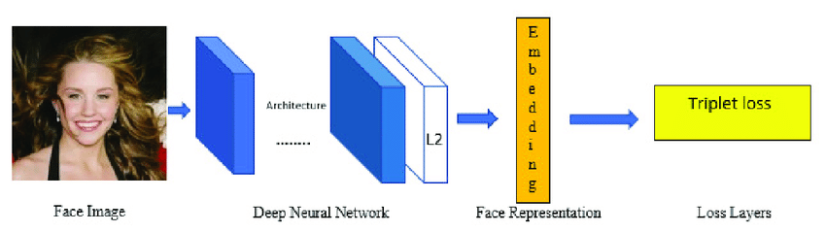
FaceNet

Slide 8
ResNet50
The "50" in ResNet-50 refers to the number of layers in the network; it contains 50 layers deep. One of the key innovations of ResNet is the introduction of "residual blocks" that allow for the training of much deeper networks than were previously possible. These residual blocks incorporate shortcut connections (also known as skip connections) that skip one or more layers and perform identity mapping. By adding the input of the block to its output, these connections help to mitigate the vanishing gradient problem, enabling the network to learn effectively even when it is very deep.

Slide 9
Feature Extraction and Dimension Reduction
FaceNet:
FaceNet creates embeddings that distinguish facial features effectively
FaceNet maps facial images to a multi-dimensional space, clustering embeddings of the same face closely together, and separating those of different faces => easily facilitates face recognition and verification processes
ResNet50:
ResNet50 processes images to identify crucial patterns and characteristics within them.
ResNet50 employs a sophisticated neural network architecture to extract meaningful features from images, improving the comprehension and analysis of visual data.
Dimension Reduction:
For dimension reduction we are using PCA and LDA
After fine tuning of the dimensions, we set the component number to 15

Slide 10
Pipeline 1
Algorithms
KNN
46.6%
56.13%
61.94%
58%
Dataset
Bayesian Classifier
SVM
Decision Tree

Slide 11
Pipeline 2
Data curation & preprocessing
Feature Extraction & Dimensionality Reduction
Algorithms
KNN
Dataset
MTCNN
PCA
Bayesian Classifier
SVM
Decision Tree

Slide 12
Pipeline 3
Data curation & preprocessing
Feature Extraction & Dimensionality Reduction
Algorithms
KNN
Dataset
MTCNN
LDA
Bayesian Classifier
SVM
Decision Tree

Slide 13
Pipeline 4
Data curation & preprocessing
Feature Extraction & Dimensionality Reduction
Algorithms
KNN
Dataset
MTCNN
PCA
Bayesian Classifier
SVM
LDA
Decision Tree

Slide 14
Pipeline 5
Data curation & preprocessing
Feature Extraction & Dimensionality Reduction
Algorithms
KNN
Dataset
MTCNN
Facenet
PCA
Bayesian Classifier
SVM
Decision Tree

Slide 15
Pipeline 6
Data curation & preprocessing
Feature Extraction & Dimensionality Reduction
Algorithms
KNN
Dataset
MTCNN
Facenet
PCA
Bayesian Classifier
SVM
LDA
Decision Tree

Slide 16
Pipeline 7
Data curation & preprocessing
Feature Extraction & Dimensionality Reduction
Algorithms
KNN
Dataset
MTCNN
ResNet50
PCA
Bayesian Classifier
SVM
Decision Tree

Slide 17
Pipeline 8
Data curation & preprocessing
Feature Extraction & Dimensionality Reduction
Algorithms
KNN
Dataset
MTCNN
ResNet50
PCA
Bayesian Classifier
SVM
LDA
Decision Tree

Slide 18
Project Result
 | KNN | Bayesian Classifier | SVM | Decision Tree
Raw Data | 46.6% | 56.13% | 61.94% | 58%
MTCNN+PCA | 76.88% | 60.767% | 86% | 63.02%
MTCNN+LDA | 79.43% | 60.65% | 90.78% | 63.177%
MTCNN+PCA+LDA | 79.47% | 63.99% | 90.77% | 63.44%
MTCNN+ FaceNet+PCA | 100% | 99.2% | 100% | 93.498%
MTCNN+ FaceNet+PCA+LDA | 100% | 99.7% | 100% | 96.66%
MTCNN+ ResNet50+PCA | 82.37% | 72.34% | 93.55% | 70.04%
MTCNN+ ResNet50+PCA+LDA | 86.02% | 72.45% | 94.1% | 74%

Slide 19
Key Challenges and solutions
Low Quantity of Data, Ineffective model tuning, No meaningful patterns | Generated more data and trained our models on higher volumes of data
Curse of dimensionality | Dimensionality reduction
Multiple faces in an single image. | Cropping the largest face
Some pictures where faces were not easily recognizable due to spectacles and low quality of images | Pruned the poor quality images
Varying parameters of augmentation affected the model performance | Selection of Augmentation Function, Hyperparameter Tuning- GridsearchCV

Slide 20
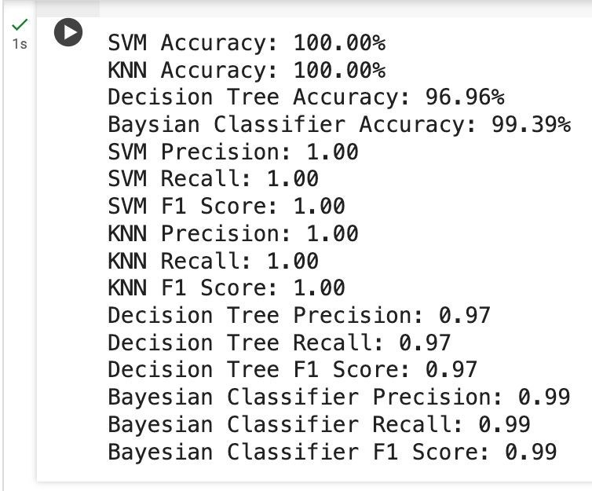
Summary
LDA's ability to maximize class separability and minimize within-class variance further enhances the quality of the features for classification tasks.
FaceNet appears to outperform ResNet50 for face recognition tasks, likely due to its specialized training for generating discriminative face embeddings
Importance of careful preprocessing and feature engineering
Right combination of techniques and hyperparameter tuning

Slide 21
Task Distribution
Sai Revanth Sivaraju | Data Curation, Data Augmentation + MTCNN+ Experimenting with raw data, PCA, LDA, PCA+LDA without facenet, Fine tuning
Vamsi Krishna Satyasi | Data Curation,Data Augmentation + Experimenting with Facenet, PCA+LDA, Fine tuning
Rajashekar Vennavelli | Data Curation, Data Augmentation + ResNet50,PCA+LDA + Fine tuning

Slide 22
References
https://medium.com/@saranshrajput/face-detection-using-mtcnn-f3948e5d1acb
https://medium.com/@nitishkundu1993/exploring-resnet50-an-in-depth-look-at-the-model-architecture-and-code-implementation-d8d8fa67e46f
https://medium.com/@culuma/face-recognition-with-facenet-and-mtcnn-11e77240adb6

Slide 23
Any Questions? Thank you

